Slide 1
Introduction to Causal Inference

Slide 2
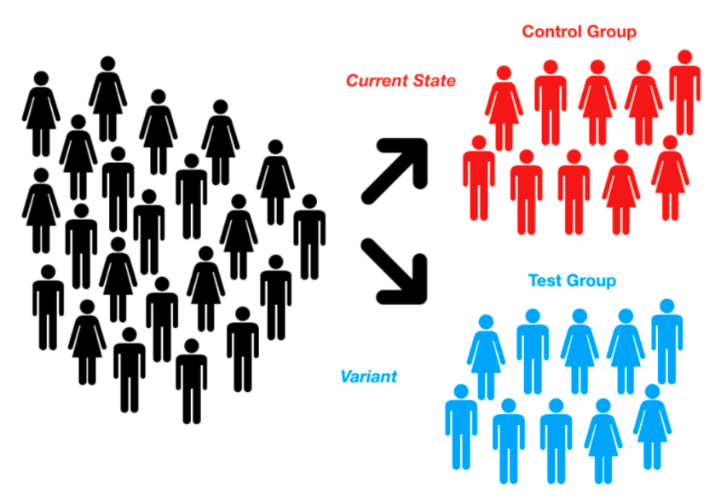
Recap of AB testing

Slide 3
Recap of AB testing
Disadvantage:
Ethical: Sometimes it is unethical to test on users (e.g. in medical field, you cannot test the effect of smoking on pregnant women)
Time: Need time to collect result (at least 2 weeks)
Sample size: Might not be applicable to company with less users (ví dụ công ty K, sản phẩm C)
Costly: Need company maturity to implement

Slide 4
Enters Causal Inference
Advantage:
Can work on historical data
Only require observational data (i.e. No intervention needed)
Disadvantage:
Less reliable

Slide 5
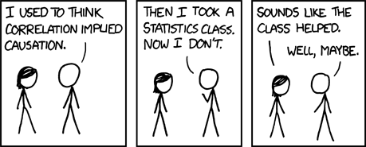
What is Causality

Slide 6
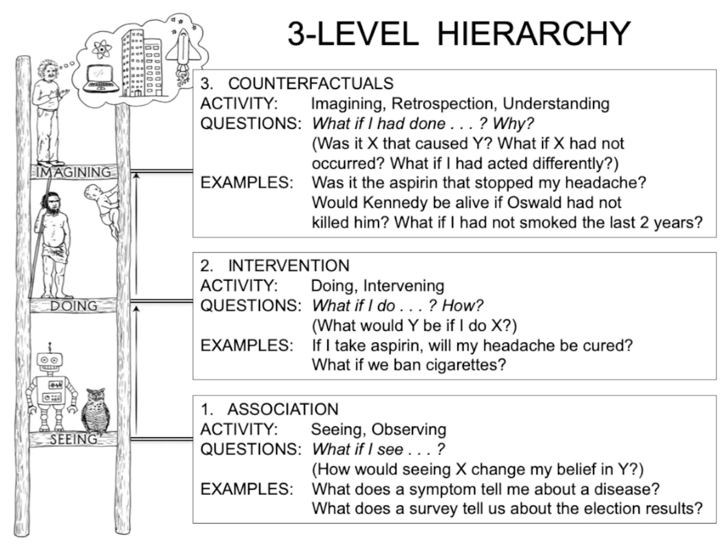
What is Causality

Slide 7
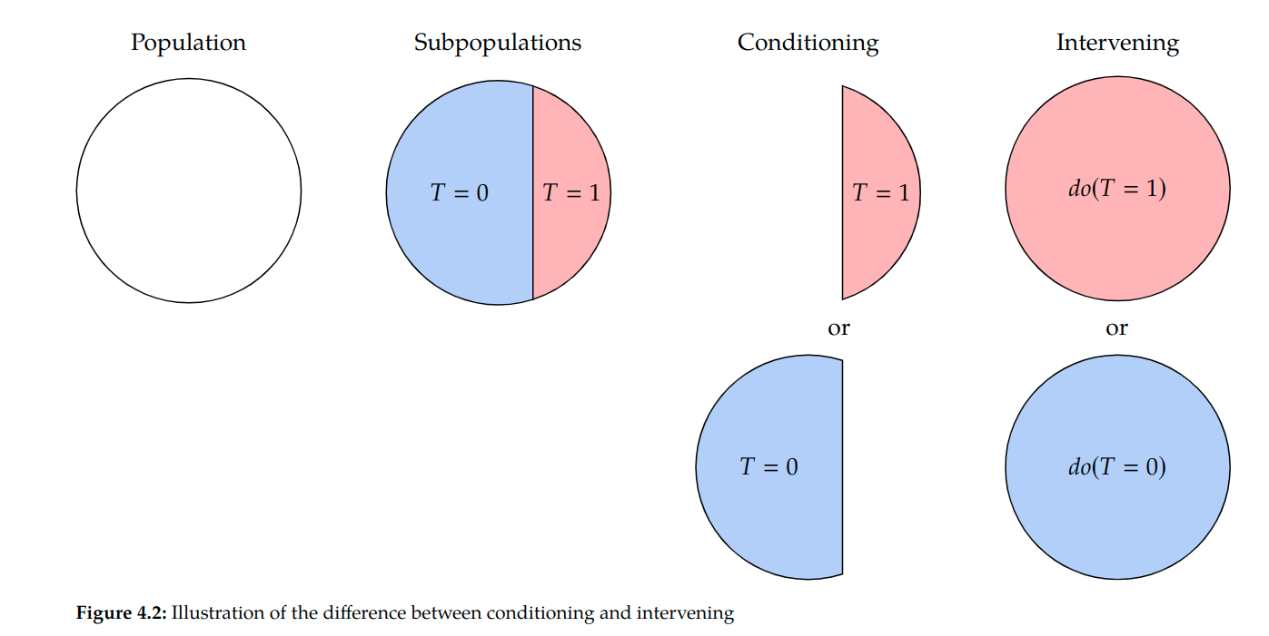
Definition (my opinion)
Let there be T = Treatment(0 or 1), and Y be result (0 or 1).
T = 1 causes Y iff: Y|do(T=1) != Y|do(T=0)
* (do(T) is the act of actively, physically set T to a value)

Slide 8
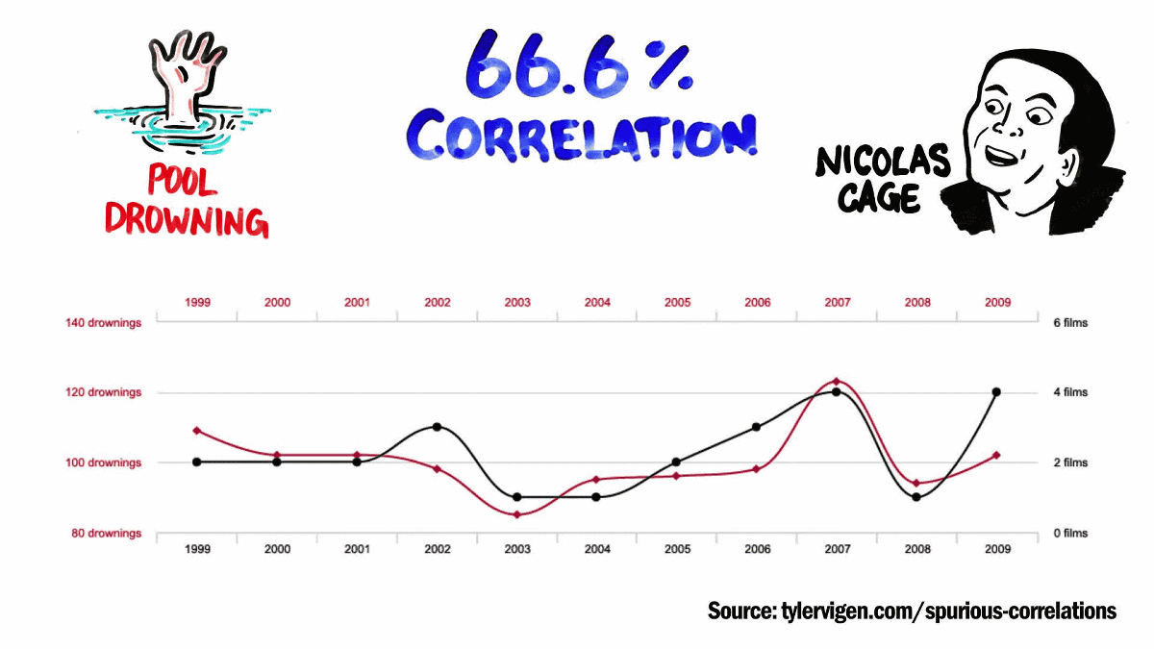
Test my definition
Test 1: Spurious correlation

Slide 9
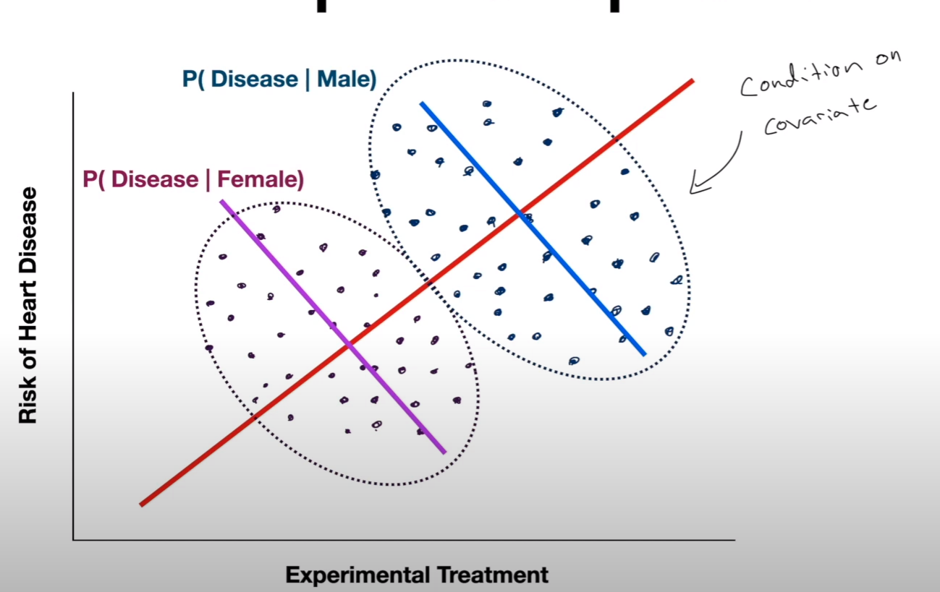
Test my definition
Test 2: Simpson Paradox

Slide 10
Some maths
Individual Treatment Effect is impossible to measure
AB test (control randomized trial) - Average Treatment Effect

Slide 11
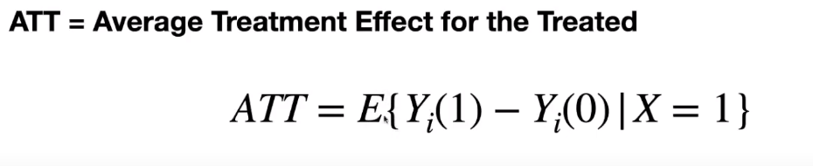
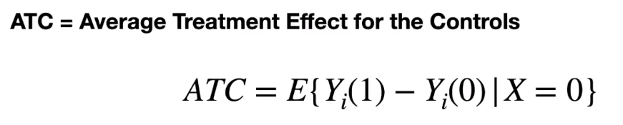
Some maths (cont)

Slide 12
Key to causality: Counterfactual
User i is given treatment A = 1. We observed Y(1). How do we estimate Y(0)?
2 methods:
Propensity score
Meta learner model

Slide 13
Create Counterfactual using Propensity score
Create a model (usually a logistic regression) with target variable = A (is treated or not), and input variables = the rest.
Fit and infer the model on ALL users.
Each user now has a score (called Propensity Score)
Matching users with similar Propensity Score (called Propensity Score matching. Can also use Stratification, inverse propensity score weighting, ...) from group treated and untreated
For each pair, calculate the ITE
Average ITE to get ATE

Slide 14
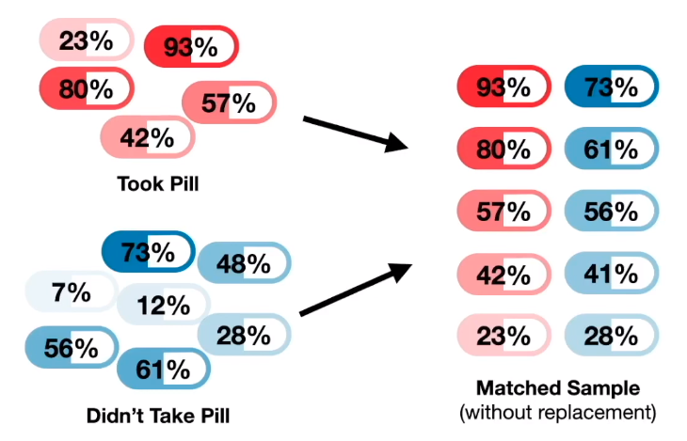
Create Counterfactual using Propensity score

Slide 15
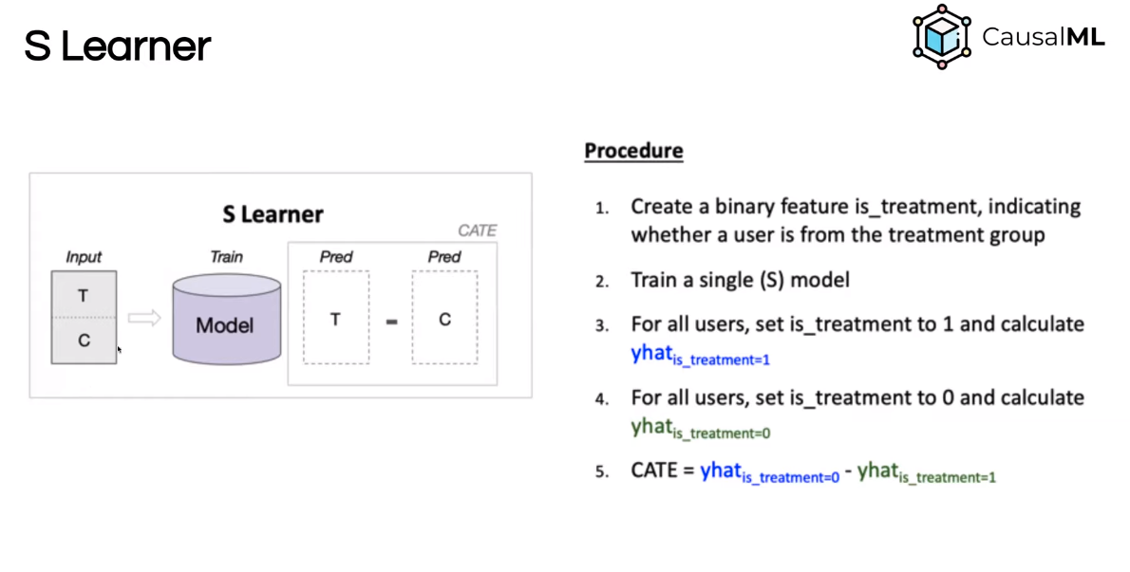
Create Counterfactual using Meta learner

Slide 16
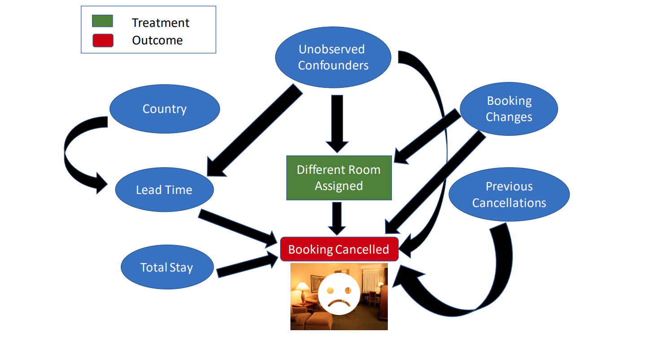
(Optional) Use DAGs to eliminate confounders

Slide 17
Demo
SimpsonParadox.ipynb
sodium_example.ipynb
https://github.com/py-why/dowhy/blob/main/docs/source/example_notebooks/DoWhy-The%20Causal%20Story%20Behind%20Hotel%20Booking%20Cancellations.ipynb

Slide 18
Resources
https://www.bradyneal.com/Introduction_to_Causal_Inference-Dec17_2020-Neal.pdf
https://www.coursera.org/learn/crash-course-in-causality/home/welcome
https://www.pywhy.org/dowhy/v0.9.1/index.html
https://towardsdatascience.com/beyond-predictive-models-the-causal-story-behind-hotel-booking-cancellations-d29e8558cbaf
https://towardsdatascience.com/causal-effects-f30f962ffff3

